Slide 1
QUALYS ADDITIONAL FEATURES
Lets have a look at Qualys additional features

Slide 2
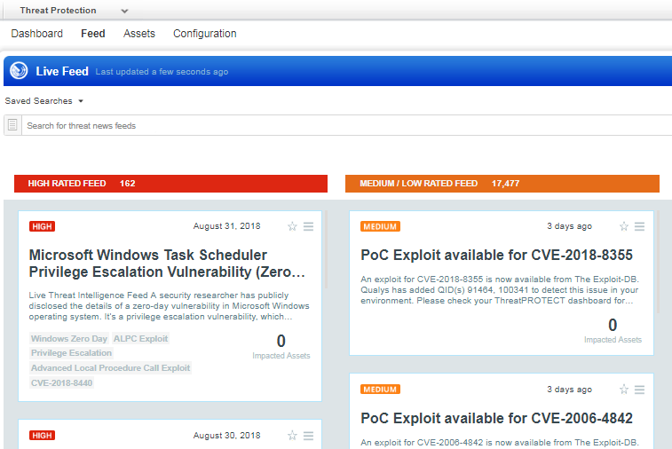
QUALYS ADDITIONAL FEATURES
QUALYS THREAT PROTECTION

Slide 3
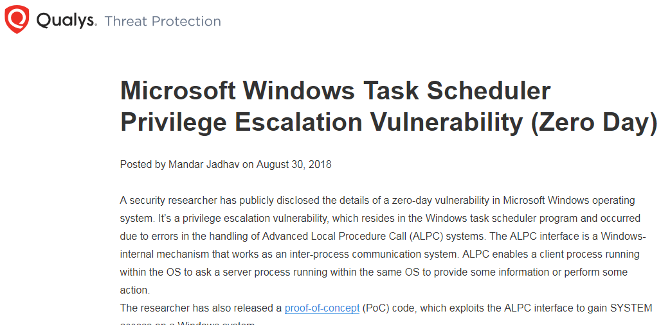
QUALYS ADDITIONAL FEATURES
QUALYS VULNERABILITY DESCRIPTION

Slide 4
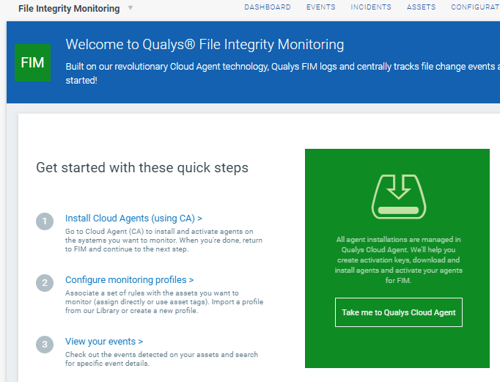
QUALYS ADDITIONAL FEATURES
FILE INTEGRITY MONITORING

Slide 5
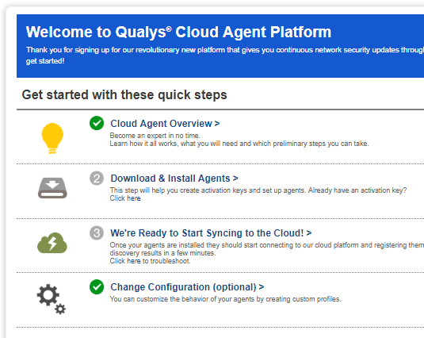
QUALYS ADDITIONAL FEATURES
QUALYS CLOUD AGENT

Slide 6
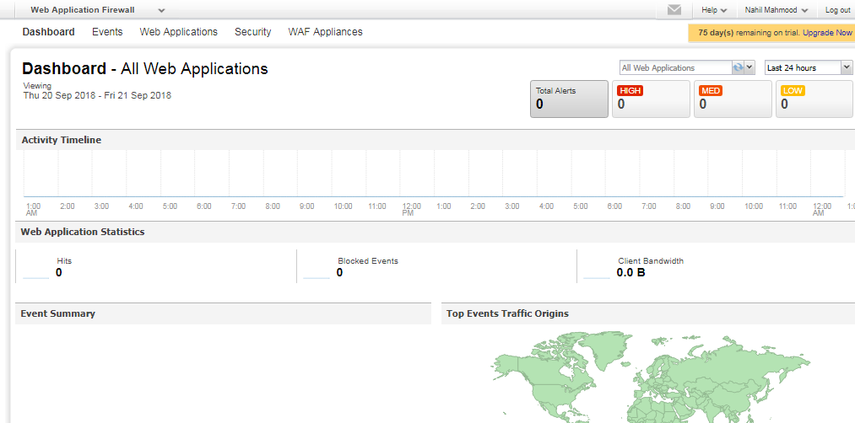
QUALYS ADDITIONAL FEATURES
WEB APPLICATION FIREWALL

Slide 7
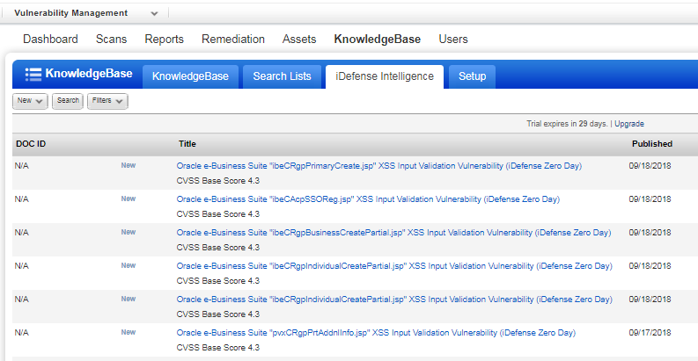
QUALYS ADDITIONAL FEATURES
iDefense Intelligence

Slide 8
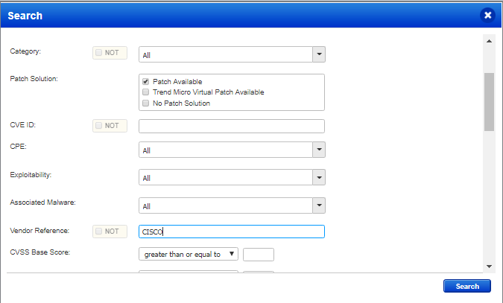
QUALYS ADDITIONAL FEATURES
SEARCH KNOWLEDGEBASE

Slide 9
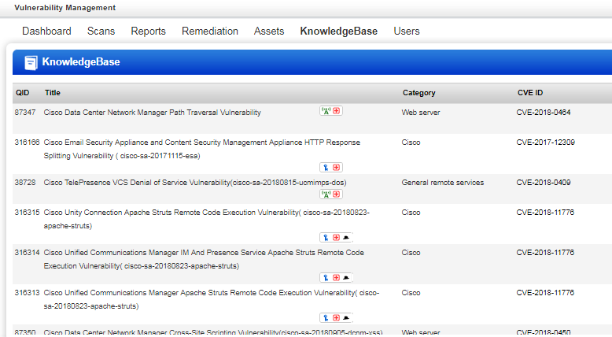
QUALYS ADDITIONAL FEATURES
CISCO VULNERABILITIES – PATCH AVAILABLE

Slide 10
QUALYS ADDITIONAL FEATURES
Have a look at additional features in your Qualys free trial
END

